Slide 1

UPI FRAUD DETECTION USING MACHINE LEARNING
by
S. Jaheda
Roll No. 214G1A3229
G. Afra Tahaseen
Roll No. 214G1A3202
K. Divya Madhuri
Roll No. 214G1A3219
P. Mohammad Arshad
Roll No. 214G1A3253
Under the guidance of
Ms. P. Sirisha _{M. Tech.}
Assistant Professor
Department of Computer Science and Engineering (Data Science)
Srinivasa Ramanujan Institute of Technology
(Affiliated to JNTUA & Approved by AICTE) (Accredited by NAAC with ‘A’ Grade & Accredited by NBA (EEE, ECE & CSE)
Rotarypuram Village, B K Samudram Mandal, Ananthapuramu – 515701.
2024 - 2025

Slide 2

Contents
Abstract
Problem Statement
Objectives
Introduction
Literature survey
Existing System
Proposed System

Slide 3
Contents
Requriments
Data Flow Diagram
Implementation
Data Processing Techniques
Screenshots(project output)
References
GitHub Link

Slide 4
Review-0 Queries
Are there any specific datasets already available for this task?
Are there additional features beyond transaction details that need to be considered?
Where can this be applied?
How many attributes are required and used in this?

Slide 5
Review-1 Queries
Are there additional features beyond transaction details that need to be considered?
What is overfitting?
What makes the model unique from other existing models?
What is the overview?

Slide 6
Abstract
The widespread adoption of Unified Payments Interface (UPI) for digital transactions has significantly increased the risk of fraudulent activities. To address this challenge, we propose a novel machine learning-based approach to detect UPI fraud. Our method employs four machine learning algorithms: Decision Tree, Random Forest (RF), Gradient Boosting (GB), and Extreme Gradient Boosting (XGBoost). DT provides an interpretable framework for anomaly detection, while RF improves robustness and accuracy by aggregating decision trees. GB and XGBoost capture intricate patterns in the data, with XGBoost excelling in handling imbalanced datasets through advanced regularization techniques. Using these algorithms, our system classifies transactions as either “Transaction Failed: Incorrect Details Entered” or “Transaction Successful: Details Verified and Processed.” significantly contributing to the security of UPI transactions. Keywords: UPI Digital Payments, Random Forest Algorithm, Decision Tree Classifier, XGBoost, Gradient Boosting

Slide 7
Problem Statement
The rise in UPI transactions has led to an increase in fraudulent activities, making it essential to develop a robust fraud detection system to safeguard users and financial institutions.
Existing fraud detection methods often suffer from high false positives, incorrectly flagging legitimate transactions, which affects user experience and trust in digital payment systems.
Traditional rule-based fraud detection approaches struggle to adapt to evolving fraud patterns, necessitating the use of machine learning algorithms for more accurate and dynamic fraud detection.

Slide 8
Objectives of Project
Development of Fraud Detection System: The project focuses on creating a robust fraud detection system specifically for Unified Payments Interface (UPI) transactions, analyzing critical details like bank book name, transaction ID, and transaction amount.
Machine Learning Algorithms: We aim to implement a framework using machine learning algorithms, including Random Forest, XGBClassifier, Gradient Boosting and Decision Tree, to effectively classify transactions as either fraudulent or successful.
Accuracy and Minimized False Positives: The goal is to enhance the accuracy of fraud detection while minimizing false positives, ensuring that legitimate transactions are not incorrectly flagged.
Integration into Financial Systems: Ultimately, the proposed model will be integrated into real-world financial systems, providing users with increased protection against unauthorized transactions and fostering confidence in digital payment processes.

Slide 9
Literature Survey
s.no | Title | Author | Journal Name &year | Methodology adapted | Key findings | gaps
1. | Secure UPI: Machine Learning-Driven Fraud Detection System for UPI Transactions | Rupa Rani, Adnan Alam, Abdul Javed | 2024 2nd International Conference on Disruptive Technologies (ICDT) | Used XGBoost with techniques | addressing dataset imbalances | Risk of overfitting .
2. | A review of credit card fraud detection using machine learning techniques | Nadia Boutaher , Amia elomri, noreddine abghour, khalid Moussaid | 5th International Conference onCloudTech,2020 | Comparative study of ML techniques | Addressed challenges of big data variety and velocity | Poor scalability in real-time

Slide 10
Literature Survey
No | Title | Author | Journal Name & Year | Methodology Adapted | Key Findings | Gaps
3. | UPI fraud Detection using Machine Learning | Yash Patil, Amar Shinde, Yash Parthe, Sameer Sayyad | International Journal of Advances in Engineering and Management (IJAEM) September-2024 | Machine Learning Techniques | Easily handles large dataset | Risk of overfitting, Limited to supervised learning; scalability
4. | UPI Fraud Detection Using Convolutional Neural Networks(CNN) | Melam nagaraju, yarramreddy chandrasena reddy, polavarapu Nagendra babu,Venkata sai pavan ravipati, velpula Chaitanya | Research Article, March 14th, 2024 | addressing imbalanced datasets and feature engineering | Model demonstrated robustness in feature-rich datasets. | High computational demand for real-time deployment​

Slide 11
Introduction
The associated risk of fraudulent activities regarding UPI has surged significantly. To combat this challenge, we propose a robust approach to detect UPI fraud by analyzing critical transaction details.Our method employs four machine learning algorithms: Decision Tree, Random Forest, Gradient Boosting Machines (GBMs).
The Random Forest classifier is renowned for its accuracy and resistance to overfitting, making it a strong candidate for distinguishing between legitimate and fraudulent transactions. GBMs refine predictions iteratively, while strengthen the model's overall predictive power by recognizing complex and sequential patterns in transaction data.
This ensemble of techniques classifies transaction outcomes as either "Transaction Failed: Incorrect Details Entered" or "Transaction Successful: Details Verified and Processed." By integrating these methods, our model aims to enhance the security of UPI transactions, ensuring smoother processing of legitimate activities while mitigating the threat of fraud.

Slide 12
Existing System
The existing systems for fraud detection in digital transactions often rely on traditional machine learning algorithms. However, many of these systems suffer from scalability issues and poor generalization due to their reliance on models that are sensitive to noisy or irrelevant features.
Additionally, algorithms such as Decision Trees, k-Nearest Neighbors (KNN), and other simpler models can become computationally expensive with large datasets, resulting in inefficiencies, especially in real-time applications.
KNN, in particular, faces challenges in fraud detection due to its high computational cost during inference, as it requires calculating distances to all training samples. KNN is sensitive to irrelevant or redundant features, making it less effective when dealing with high-dimensional or noisy data.

Slide 13
Disadvantages of Existing System
Data Sensitivity: Existing systems may struggle with noisy or irrelevant features, which can lead to inaccurate predictions and decreased performance.
Scalability Issues: Simpler methods can be computationally expensive, leading to slower response times with large datasets.
Overfitting Risk: Simpler algorithms like decision trees can easily overfit to training data, impacting generalization to unseen transactions.
Imbalanced Data: Fraud detection systems often deal with imbalanced datasets, leading to biased predictions favoring legitimate transactions over fraudulent ones.

Slide 14
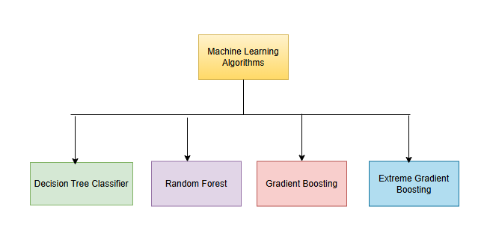
Proposed System
The proposed system for detecting UPI fraud leverages advanced machine learning algorithms to accurately analyze and classify transactions as either fraudulent or legitimate. The system is designed to efficiently handle the increasing volume of UPI transactions while maintaining high accuracy and real-time fraud detection capabilities.
The system employs four powerful machine learning algorithms to detect fraud:

Slide 15
Proposed System
Data-driven Approach: By using historical transaction data, the system can detect fraud based on actual patterns, improving its accuracy.
Versatile Model Selection: The inclusion of multiple algorithms (Decision Tree, Random Forest, and XGBClassifier, Gradient Boosting) allows for flexibility and optimization, ensuring the best-performing model is chosen.
Real time Monitoring: The integration of the system with real-time transaction data means that fraud detection is immediate, which is crucial for minimizing losses.
Performance Metrics: Evaluating the system using various performance metrics will help to fine-tune the model and ensure that it balances accuracy and detection capability.
.

Slide 16
Requirements
Functional requirements
Transaction monitoring
Fraud predictions model
Real time alerts
Fraud pattern updates
Non functional requirement
Scalability
Accuracy
Maintainability
Performance

Slide 17
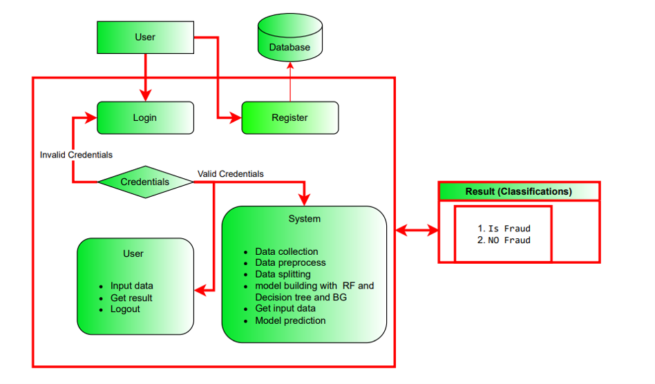
Data Flow Diagram

Slide 18
Implementation
Take the Dataset: The system accepts and processes the dataset provided by the user. This dataset forms the foundation for building the predictive model.
Preprocessing: Before training a predictive model, the system preprocesses the dataset. This includes handling missing data, data cleaning, and feature extraction. Preprocessing ensures that the data is in a suitable format for modeling.
Training: The system uses machine learning techniques and Python modules to train a model based on the preprocessed dataset. The model learns patterns and relationships within the data, allowing it to make predictions.
Generate Results: Once the model is trained, the system can generate results based on user input values. These results typically indicate whether the input data corresponds to a specific condition, event, or prediction.

Slide 19
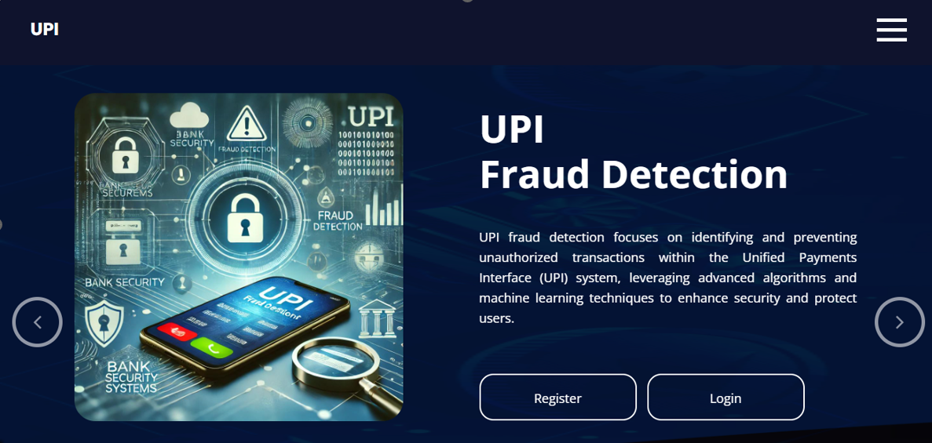
Output Screenshots

Slide 20

Output Screenshots

Slide 21

Output Screenshots

Slide 22
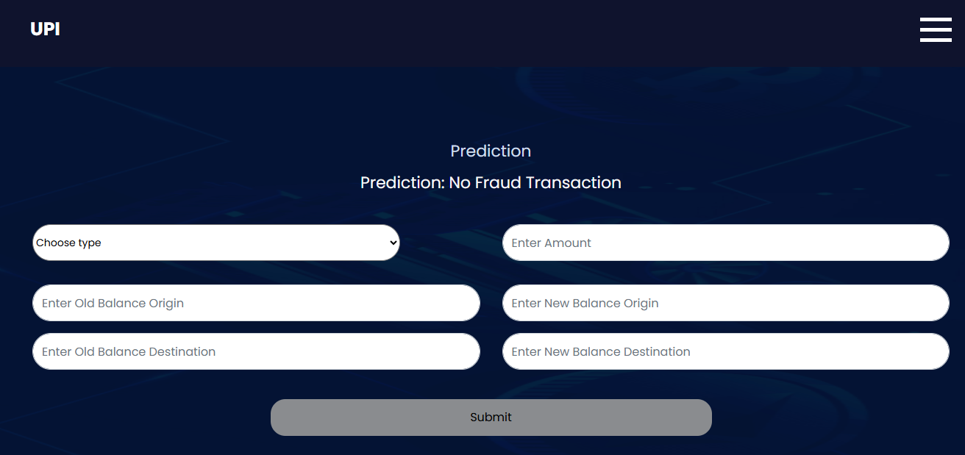
Output Screenshots

Slide 23
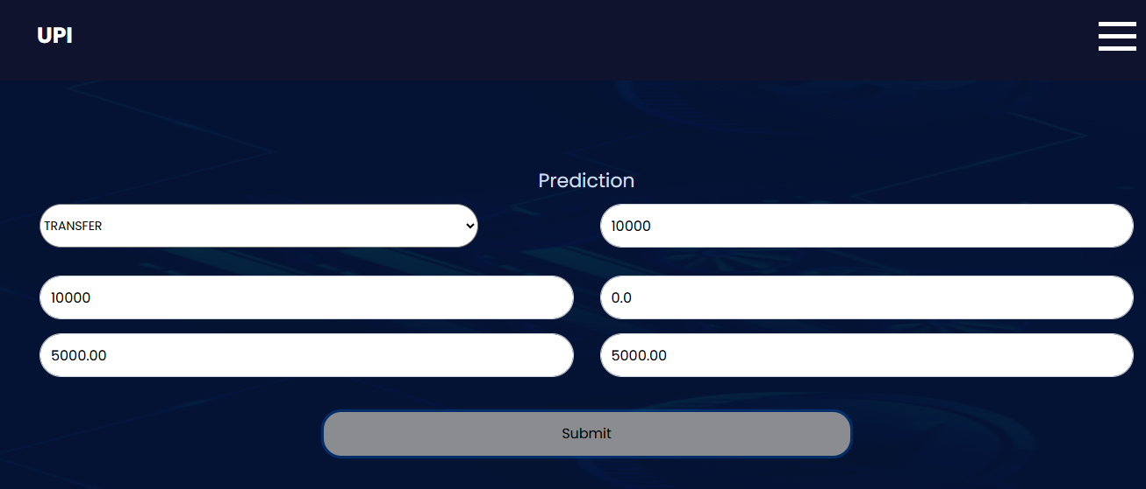
Output Screenshots

Slide 24
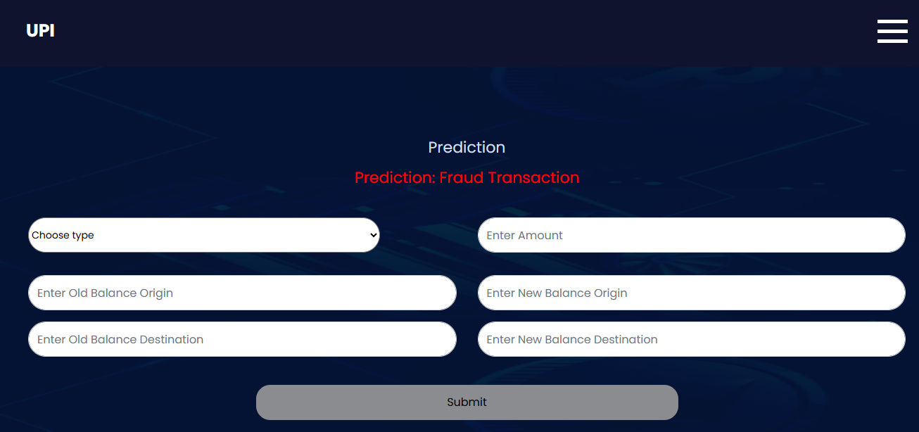
Output Screenshots

Slide 25
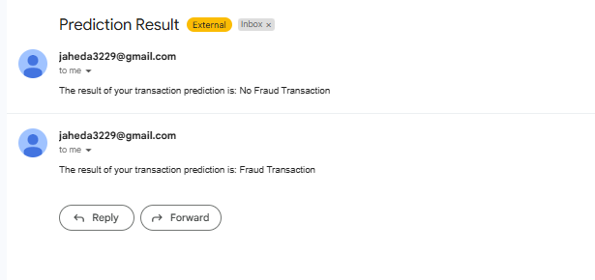
Output Screenshots

Slide 26
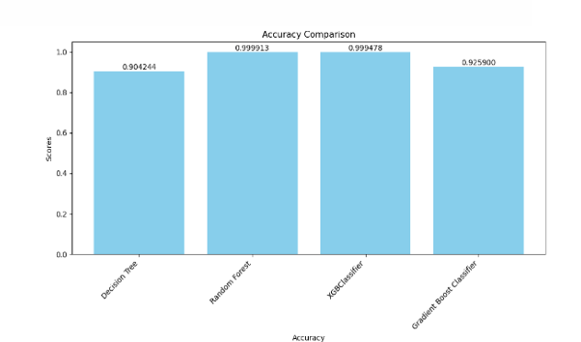
Output Screenshots

Slide 27
Conclusion
By employing Decision Trees, Random Forest, Gradient Boosting Machines (GBMs),this project enhances model interpretability and performance over traditional approaches further strengthens privacy by enabling decentralized model training, thereby preserving the confidentiality of sensitive financial data.
This dual approach not only improves the precision of fraud detection but also fosters a more transparent and privacy-preserving framework.
The results underscore the potential to advance financial fraud detection systems, ensuring both robust performance and adherence to privacy standards. This paradigm shift holds promise for more secure and accountable financial systems in the future.

Slide 28
Reference
[1]. J. Kavitha, G. Indira, A. Anil kumar , A. Shrinita , D. Bappan, Fraud Detection in UPI Transactions Using Machine Learning. EPRA International Journal of Research and Development (IJRD),April -2024
[2]. Rupa Rani, Adnan Alam, Abdul JavedSecure UPI: Machine Learning-Driven Fraud Detection System for upi Transaction.
[3]. Nadia Boutaher ,Amia elomri, noreddine abghour, khalid Moussaid ,A review of credit card fraud detection using machine learning techniques
[4].Yash Patil, Amar Shinde, Yash Parthe, Sameer Sayyad, UPI fraud Detection using Machine Learning. International Research Journal of Modernization in Engineering Technology and Science , September-2024

Slide 29
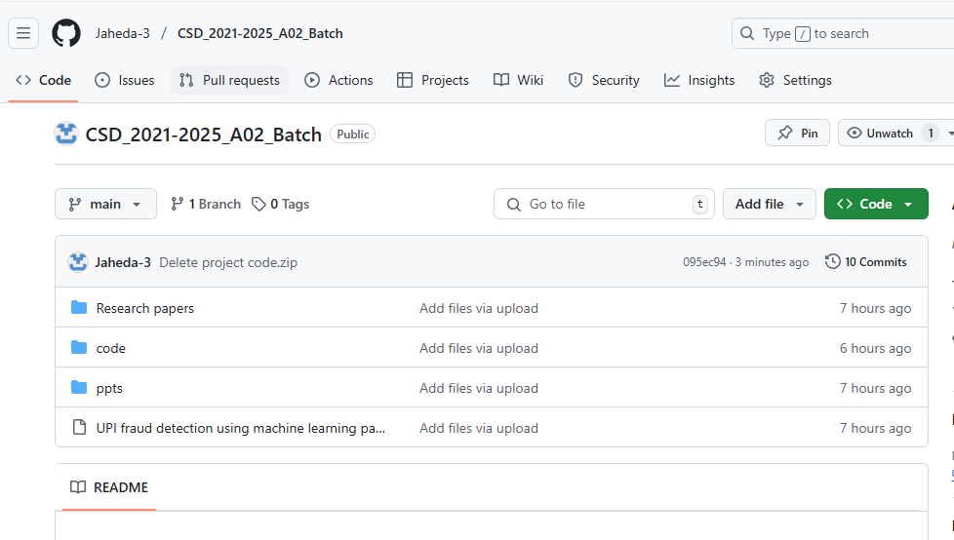
GITHUB LINK

Slide 30
Any Queries?

Slide 31
Thank You!!!

